Slide 1



Hidden Indicators of Collective Intelligence in Crowdfunding
Horvát, E-Á., Dambanemuya, H.K., Uparna, J.S., and Uzzi, B.
Northwestern University

Slide 2

Why Study Collective Intelligence in Crowdfunding?
~2,000 crowdfunding sites and over $300 Billion by 2025 [World Bank Estimate]
Growing academic interest
[Agrawal2013, Belleflamme2014, Mollick2014, Gleasure2016, Short2017]
COVID-19 Responses
CTH → world’s largest open-source library of Coronavirus tools and data (Initial Target: £27,000)
WHO → first-ever crowdfund (COVID-19 response)
Italy → record-breaking GoFundMe campaigns

Slide 3

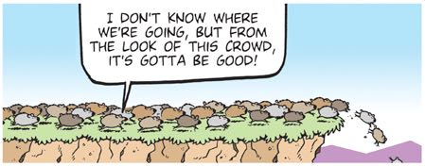


Can crowds of untrained individuals accurately predict loan outcomes?
Fundraising Success
Are loans funded or not? Herding?
Repayment Success
Will borrowers default? True CI.
ACM Web Conference (WWW ’23) Hidden Indicators of Collective Intelligence Horvát, E-Á., et al

Slide 4

What are the hidden indicators of smart crowds?
Opinion Diversity
Bikhchandani1998, Lu2012, Hui2014, Vulkan2016
Aggregation Speed
Ceyhan2011, Burtch2013, Solomon2015
ACM Web Conference (WWW ’23) Hidden Indicators of Collective Intelligence Horvát, E-Á., et al

Slide 5
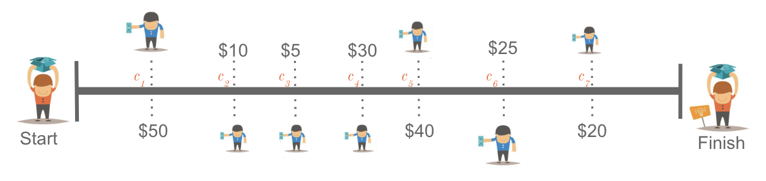
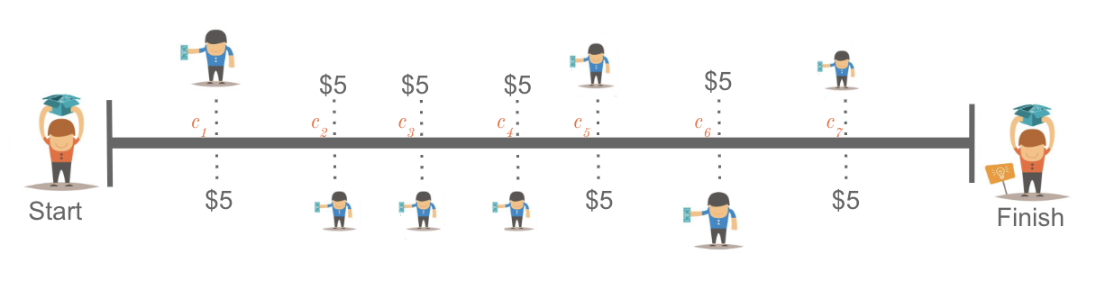
Opinion Diversity (OD)
High OD
Low OD
ACM Web Conference (WWW ’23) Hidden Indicators of Collective Intelligence Horvát, E-Á., et al

Slide 6
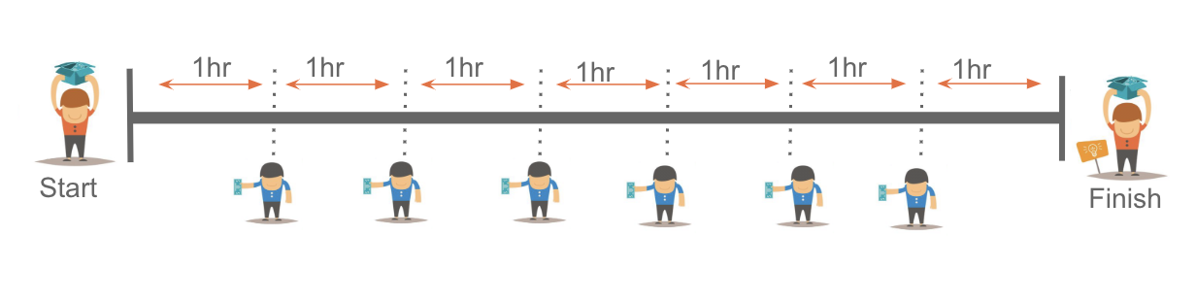
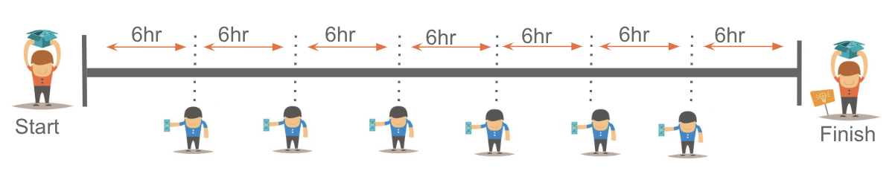
Aggregation Speed (AS)
High AS
Low AS
ACM Web Conference (WWW ’23) Hidden Indicators of Collective Intelligence Horvát, E-Á., et al

Slide 7
Aggregation Speed (AS)
High AS
Low AS
ACM Web Conference (WWW ’23) Hidden Indicators of Collective Intelligence Horvát, E-Á., et al

Slide 8
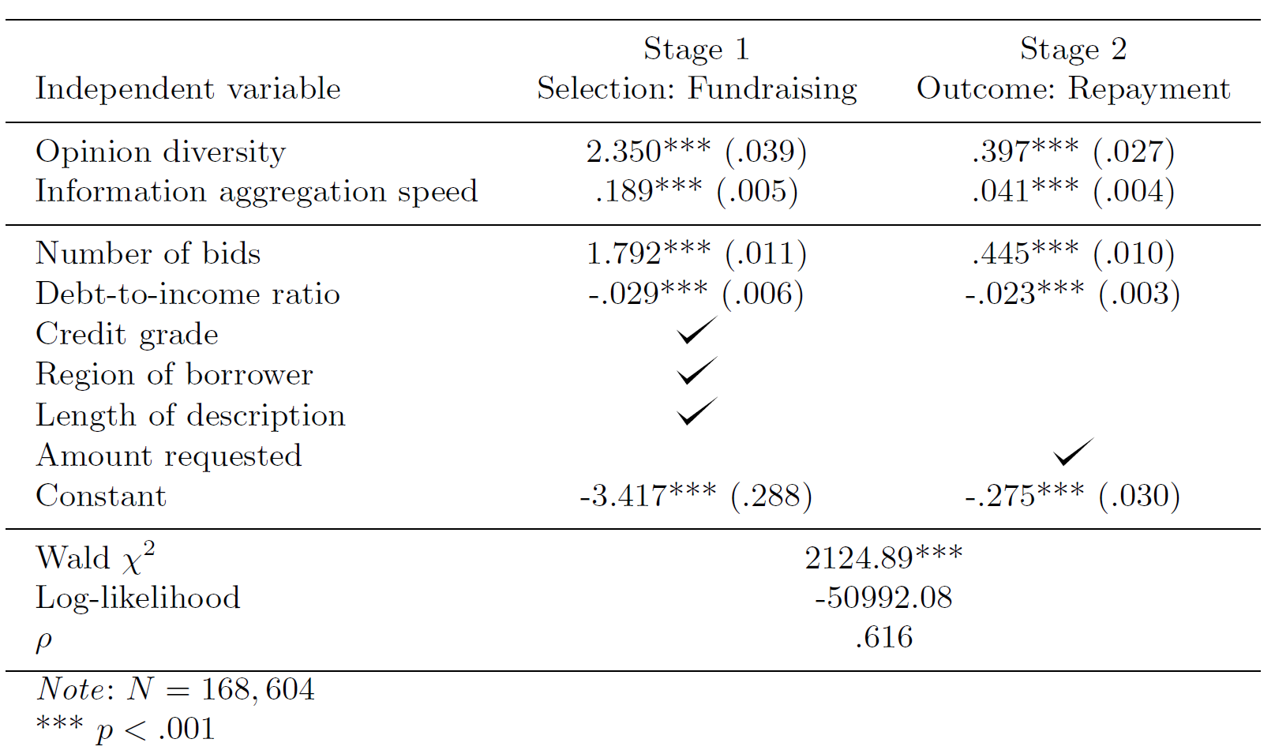
Opinion Diversity and Aggregation Speed predict funding and repayment success
The likelihood of successful fundraising increases with more diversity and faster aggregation speed
ACM Web Conference (WWW ’23) Hidden Indicators of Collective Intelligence Horvát, E-Á., et al

Slide 9
Opinion Diversity and Aggregation Speed predict funding and repayment success
The likelihood of both successful fundraising and repayment increases with more diversity and faster aggregation speed
ACM Web Conference (WWW ’23) Hidden Indicators of Collective Intelligence Horvát, E-Á., et al

Slide 10

Are the collective intelligence indicators robust to different levels of risk?
ACM Web Conference (WWW ’23) Hidden Indicators of Collective Intelligence Horvát, E-Á., et al

Slide 11
High Amount
High Risk
Medium 1 Risk
Risk categories based on:
credit grade
loan amount
Bad
Credit
Excellent
Credit
Medium 2 Risk
Low Risk
Low Amount
ACM Web Conference (WWW ’23) Hidden Indicators of Collective Intelligence Horvát, E-Á., et al
Notes:
The same analysis for repayment shows that the high diversity and high speed condition outperforms the baseline in all cases, except the 1.2% of the campaigns that are low-risk and yet have a higher success rate than expected by our indicators
The four repayment categories indicate the most interesting and important theoretical and practical findings from our study.
We see that the lift provided by crowd wisdom is statistically and substantially greater than expected by the base rate in the two categories with the highest risk.
In the high-risk category, for example, the base rate estimates a repayment in roughly 40% of the cases.
In contrast, the combination of high diversity and high speed correctly predicts repayment 55.3% of the time.
Overall, we see that campaigns that are high on one but not both collective intelligence indicators have a success rate between 43.7% and 95.2% of the base rate, while campaigns that are low on both indicators (low diversity and low speed) have success rates up to 14.1% lower than the base rate.

Slide 12
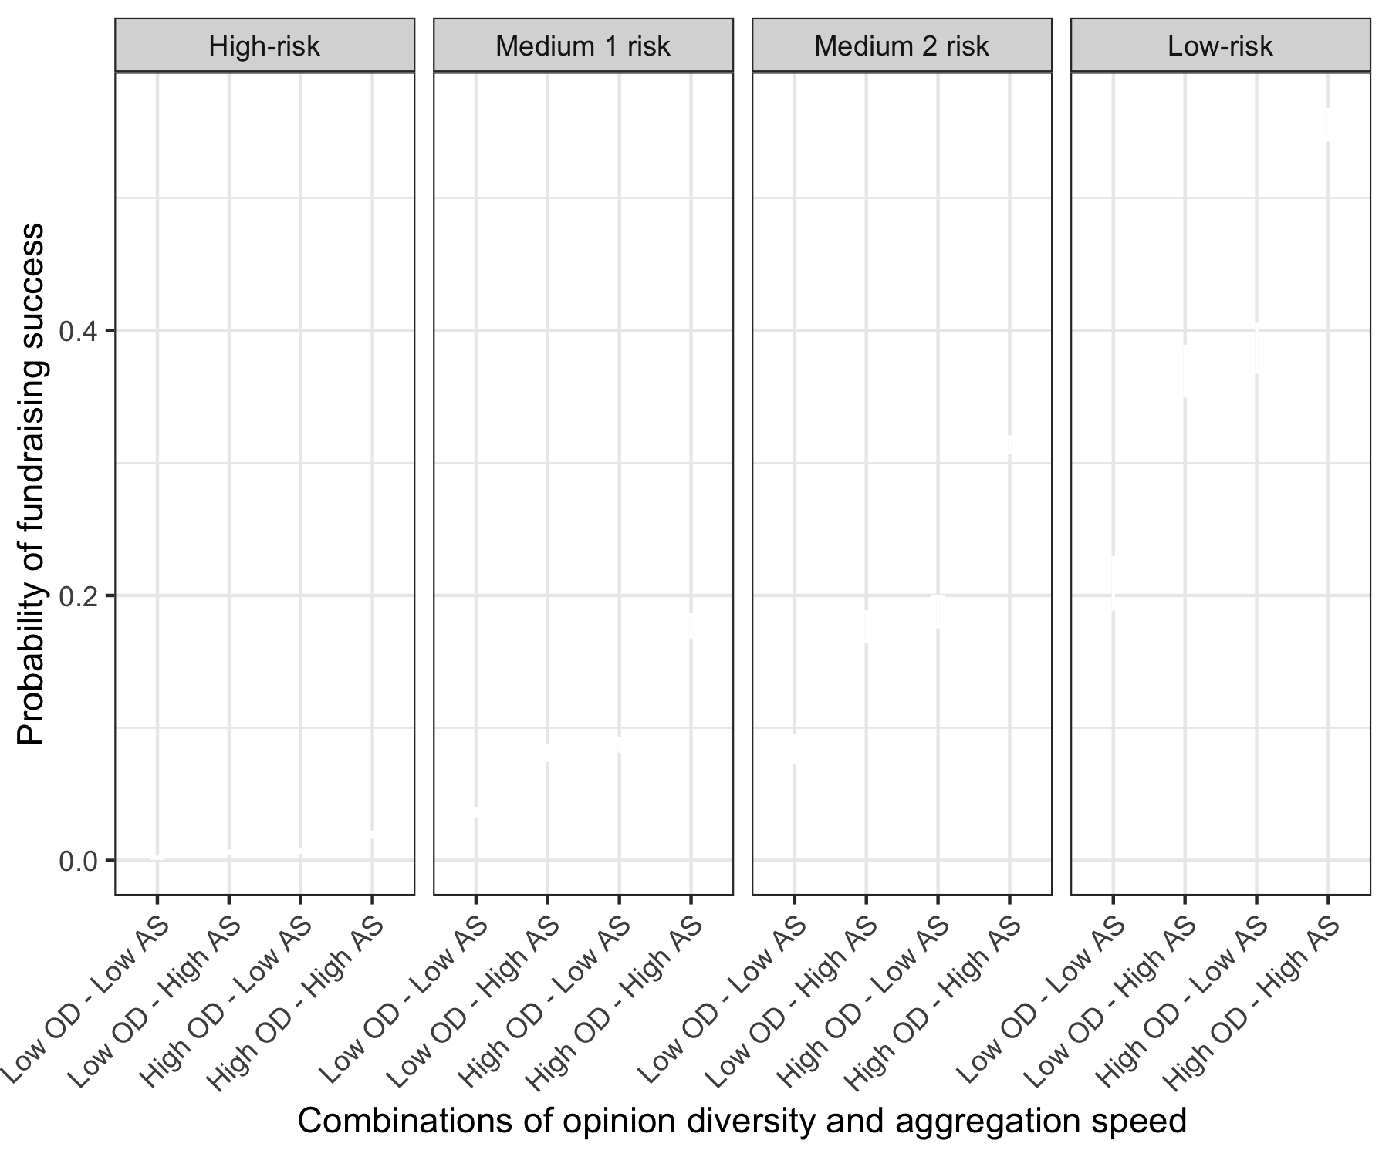
Probability of fundraising success depending on risk
ACM Web Conference (WWW ’23) Hidden Indicators of Collective Intelligence Horvát, E-Á., et al

Slide 13
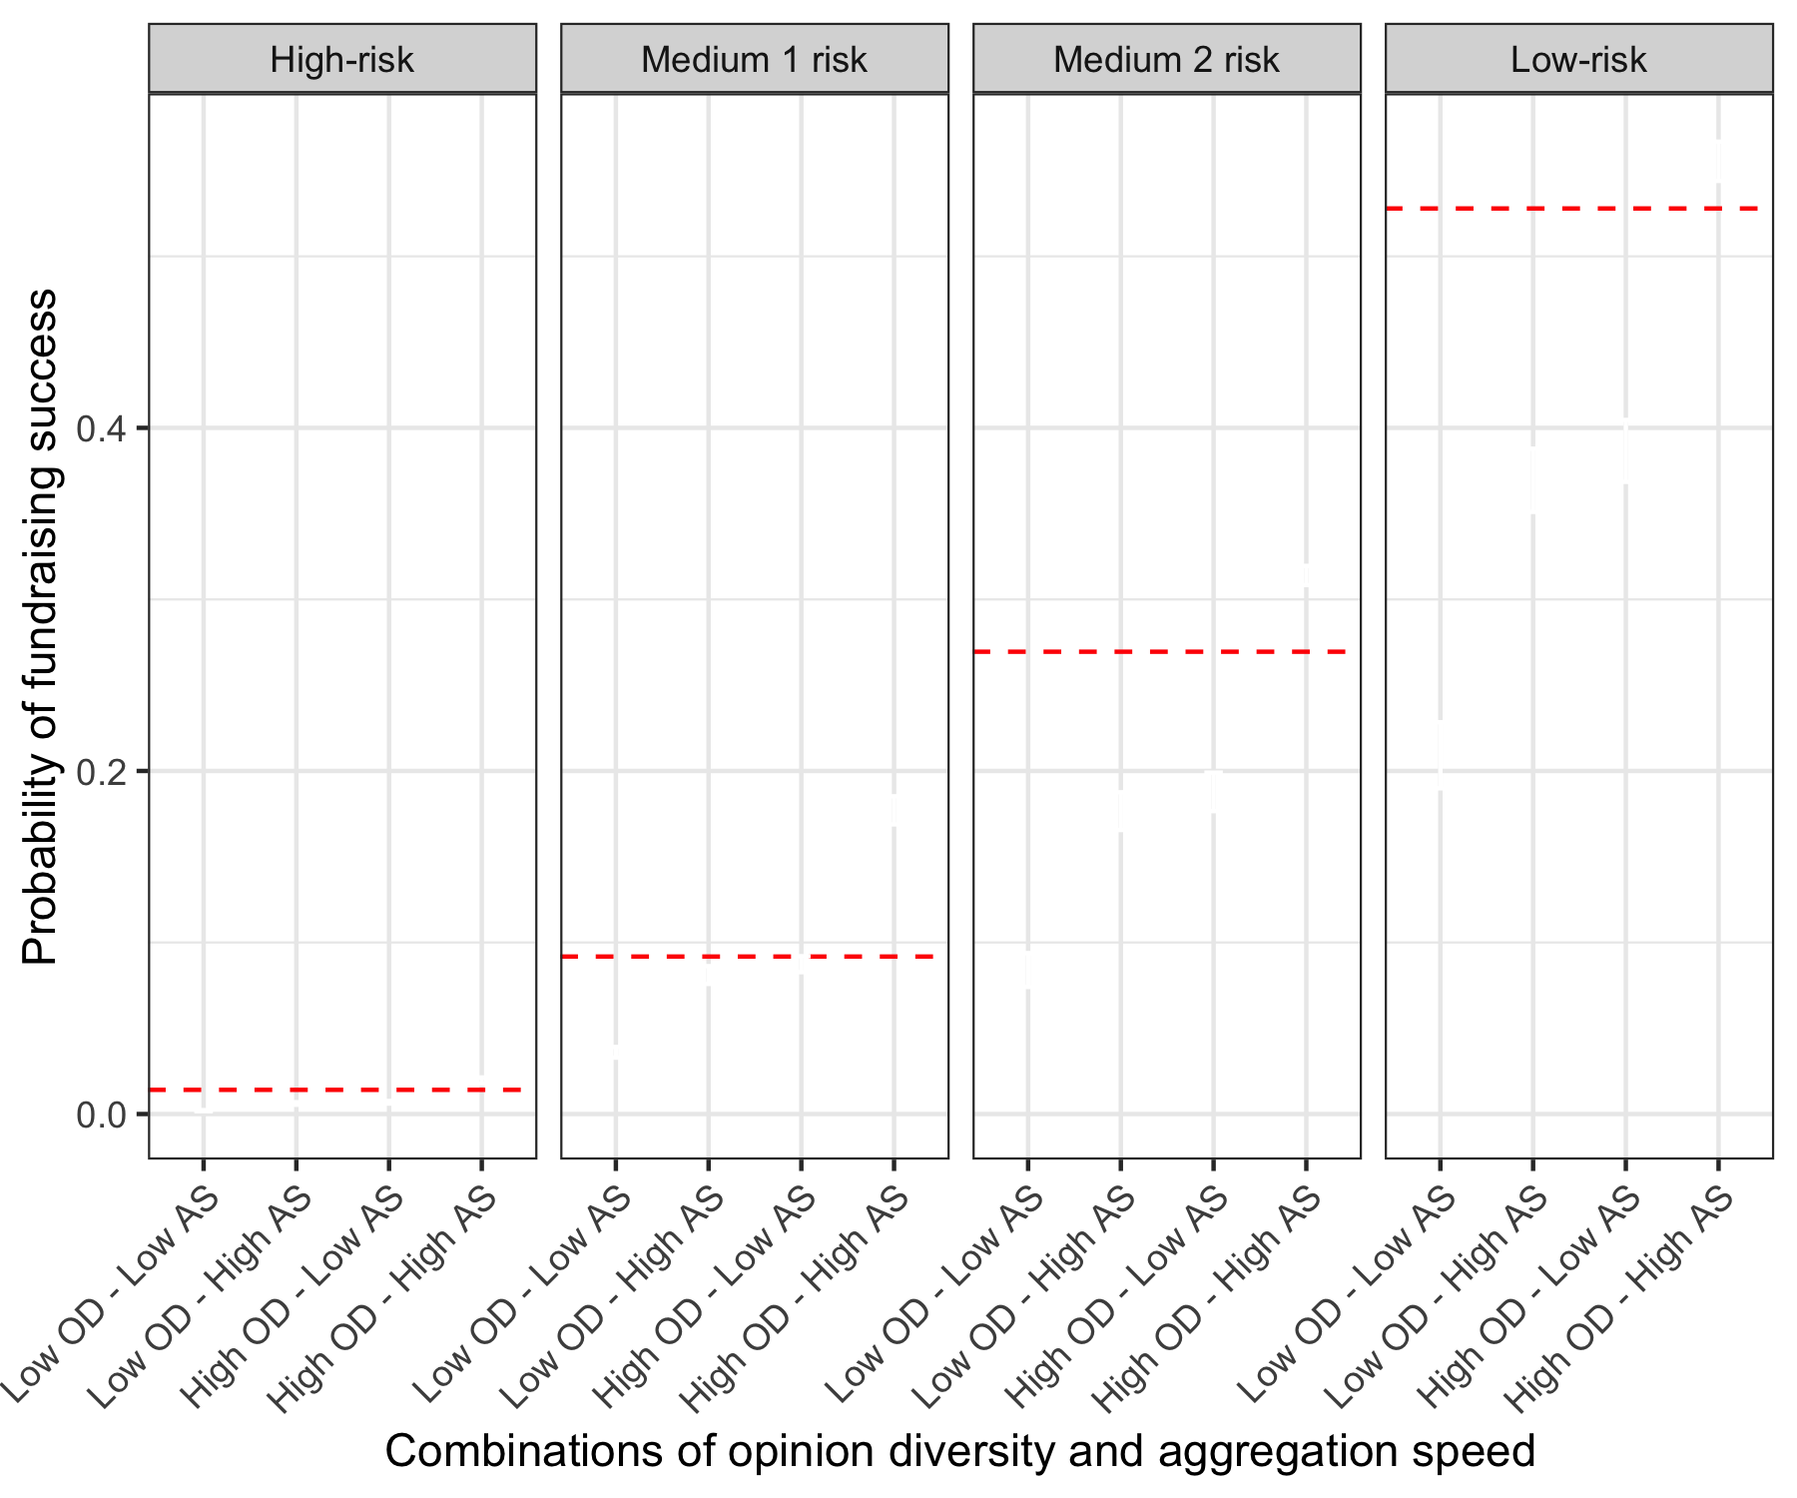
Crowds are cautious about funding high-risk campaigns
ACM Web Conference (WWW ’23) Hidden Indicators of Collective Intelligence Horvát, E-Á., et al

Slide 14
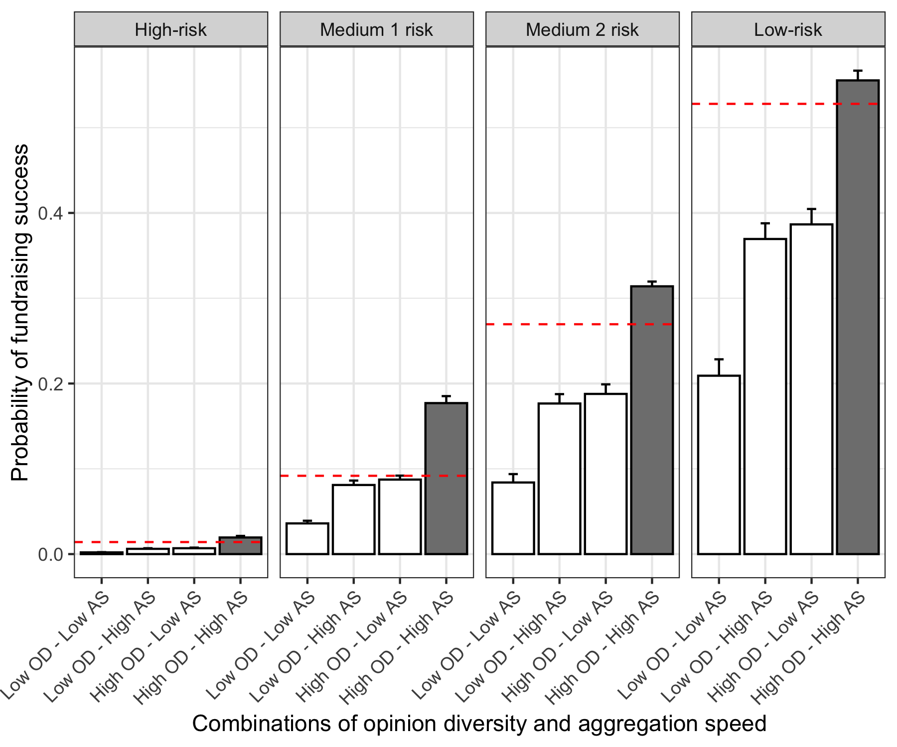
Probability of fundraising success depending on risk
ACM Web Conference (WWW ’23) Hidden Indicators of Collective Intelligence Horvát, E-Á., et al
Notes:
The collective intelligence indicators are associated with project outcomes regardless of the risk level.
I show the estimates of the likelihood of successful fundraising and repayment conditional on combinations of diversity and speed for four risk-reward levels grouped by low and high borrower credit rating and low and high loan amounts.
The estimates are computed by adding interaction effects into the regression shown eralier
In this figure generated from the Heckman selection model, the dashed horizontal red line indicates the base rates for the probability of fundraising and repayment in each of the risk categories
Campaigns that have high diversity and high speed make better predictions about the creditworthiness of a borrower and a borrower’s likelihood of default than expected by the base rate in seven out of eight risk categories
High-diversity and high-speed campaigns can be up to 92.9% better than predicted by the base rate
In all 4 risk categories, the lift from crowd wisdom over the base is statistically significant.

Slide 15

Probability of repayment success depending on risk
ACM Web Conference (WWW ’23) Hidden Indicators of Collective Intelligence Horvát, E-Á., et al
Notes:
The same analysis for repayment shows that the high diversity and high speed condition outperforms the baseline in all cases, except the 1.2% of the campaigns that are low-risk and yet have a higher success rate than expected by our indicators
The four repayment categories indicate the most interesting and important theoretical and practical findings from our study.
We see that the lift provided by crowd wisdom is statistically and substantially greater than expected by the base rate in the two categories with the highest risk.
In the high-risk category, for example, the base rate estimates a repayment in roughly 40% of the cases.
In contrast, the combination of high diversity and high speed correctly predicts repayment 55.3% of the time.
Overall, we see that campaigns that are high on one but not both collective intelligence indicators have a success rate between 43.7% and 95.2% of the base rate, while campaigns that are low on both indicators (low diversity and low speed) have success rates up to 14.1% lower than the base rate.

Slide 16
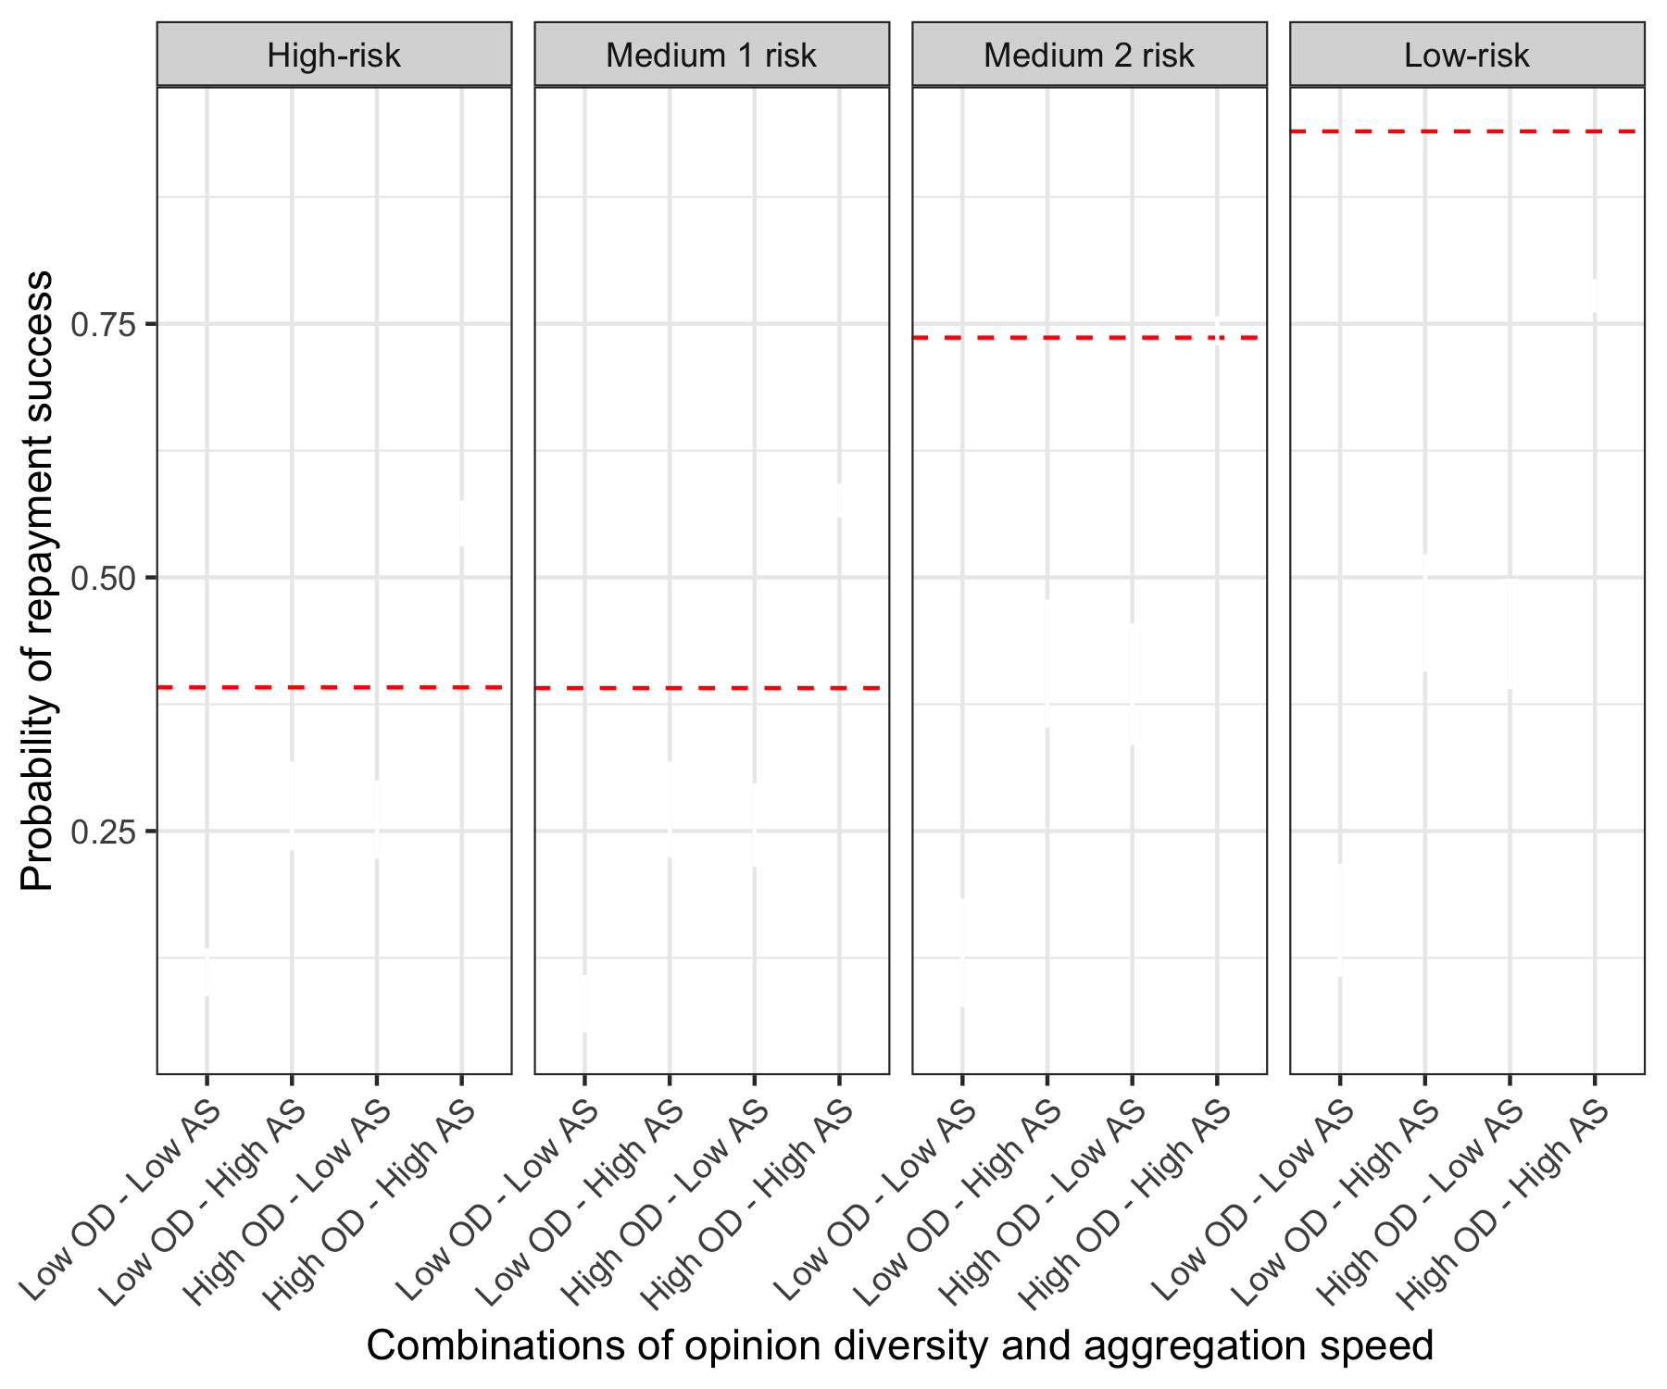
High-risk campaigns have higher probabilities of default
ACM Web Conference (WWW ’23) Hidden Indicators of Collective Intelligence Horvát, E-Á., et al
Notes:
The same analysis for repayment shows that the high diversity and high speed condition outperforms the baseline in all cases, except the 1.2% of the campaigns that are low-risk and yet have a higher success rate than expected by our indicators
The four repayment categories indicate the most interesting and important theoretical and practical findings from our study.
We see that the lift provided by crowd wisdom is statistically and substantially greater than expected by the base rate in the two categories with the highest risk.
In the high-risk category, for example, the base rate estimates a repayment in roughly 40% of the cases.
In contrast, the combination of high diversity and high speed correctly predicts repayment 55.3% of the time.
Overall, we see that campaigns that are high on one but not both collective intelligence indicators have a success rate between 43.7% and 95.2% of the base rate, while campaigns that are low on both indicators (low diversity and low speed) have success rates up to 14.1% lower than the base rate.

Slide 17
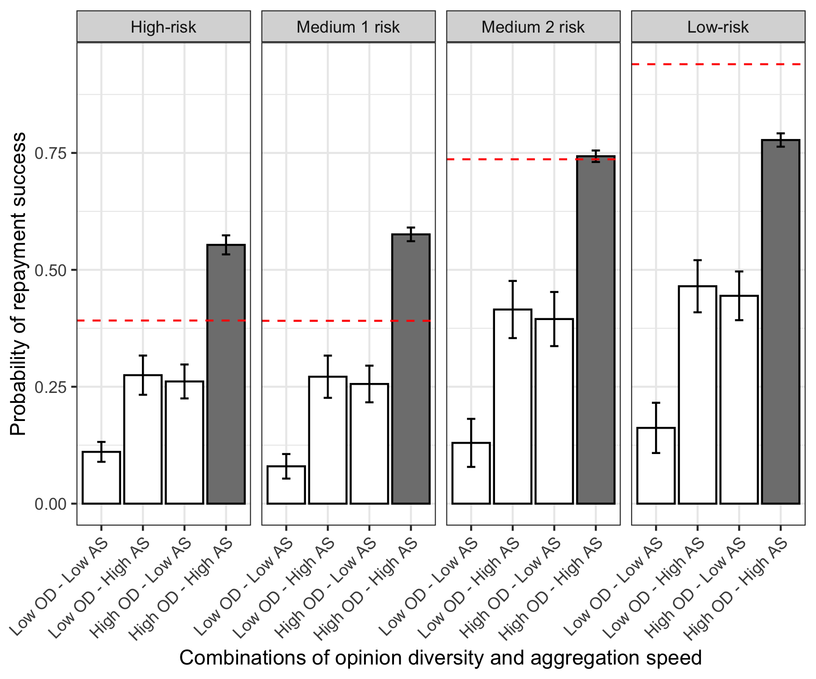
Probability of repayment success depending on risk
ACM Web Conference (WWW ’23) Hidden Indicators of Collective Intelligence Horvát, E-Á., et al
Notes:
The same analysis for repayment shows that the high diversity and high speed condition outperforms the baseline in all cases, except the 1.2% of the campaigns that are low-risk and yet have a higher success rate than expected by our indicators
The four repayment categories indicate the most interesting and important theoretical and practical findings from our study.
We see that the lift provided by crowd wisdom is statistically and substantially greater than expected by the base rate in the two categories with the highest risk.
In the high-risk category, for example, the base rate estimates a repayment in roughly 40% of the cases.
In contrast, the combination of high diversity and high speed correctly predicts repayment 55.3% of the time.
Overall, we see that campaigns that are high on one but not both collective intelligence indicators have a success rate between 43.7% and 95.2% of the base rate, while campaigns that are low on both indicators (low diversity and low speed) have success rates up to 14.1% lower than the base rate.

Slide 18
Are the collective intelligence indicators early predictors of fundraising success?
ACM Web Conference (WWW ’23) Hidden Indicators of Collective Intelligence Horvát, E-Á., et al

Slide 19
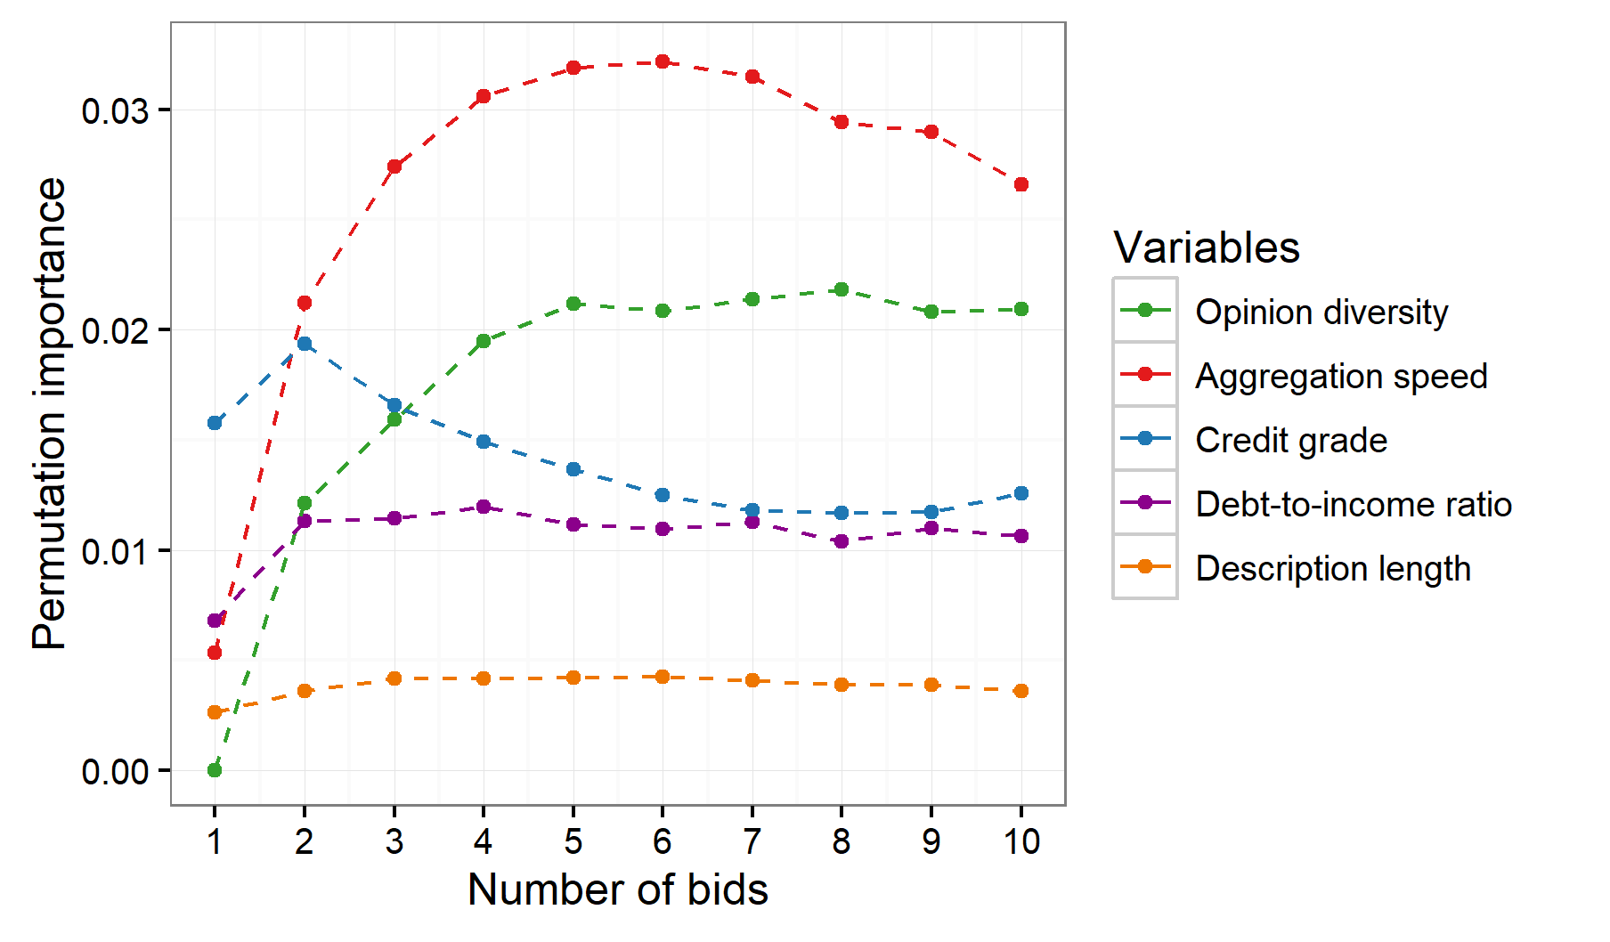
Predicting fundraising from early campaign dynamics
ACM Web Conference (WWW ’23) Hidden Indicators of Collective Intelligence Horvát, E-Á., et al
Notes:
The same analysis for repayment shows that the high diversity and high speed condition outperforms the baseline in all cases, except the 1.2% of the campaigns that are low-risk and yet have a higher success rate than expected by our indicators
The four repayment categories indicate the most interesting and important theoretical and practical findings from our study.
We see that the lift provided by crowd wisdom is statistically and substantially greater than expected by the base rate in the two categories with the highest risk.
In the high-risk category, for example, the base rate estimates a repayment in roughly 40% of the cases.
In contrast, the combination of high diversity and high speed correctly predicts repayment 55.3% of the time.
Overall, we see that campaigns that are high on one but not both collective intelligence indicators have a success rate between 43.7% and 95.2% of the base rate, while campaigns that are low on both indicators (low diversity and low speed) have success rates up to 14.1% lower than the base rate.

Slide 20
CI Indicators are early predictors of fundraising success
At only 4 bids, both collective intelligence indicators become more predictive than credit grade
ACM Web Conference (WWW ’23) Hidden Indicators of Collective Intelligence Horvát, E-Á., et al
Notes:
The same analysis for repayment shows that the high diversity and high speed condition outperforms the baseline in all cases, except the 1.2% of the campaigns that are low-risk and yet have a higher success rate than expected by our indicators
The four repayment categories indicate the most interesting and important theoretical and practical findings from our study.
We see that the lift provided by crowd wisdom is statistically and substantially greater than expected by the base rate in the two categories with the highest risk.
In the high-risk category, for example, the base rate estimates a repayment in roughly 40% of the cases.
In contrast, the combination of high diversity and high speed correctly predicts repayment 55.3% of the time.
Overall, we see that campaigns that are high on one but not both collective intelligence indicators have a success rate between 43.7% and 95.2% of the base rate, while campaigns that are low on both indicators (low diversity and low speed) have success rates up to 14.1% lower than the base rate.

Slide 21
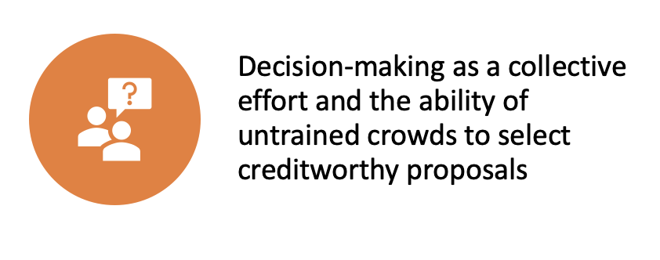
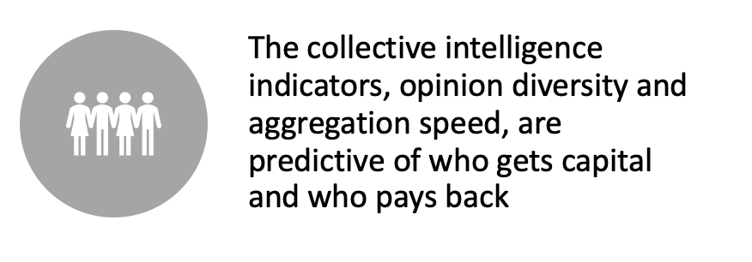
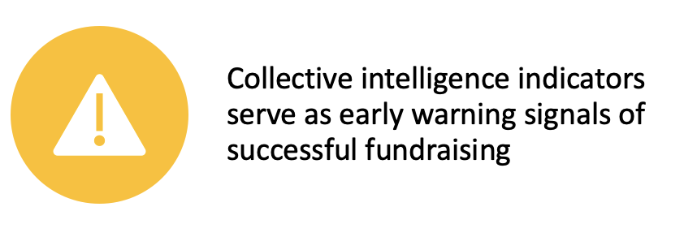
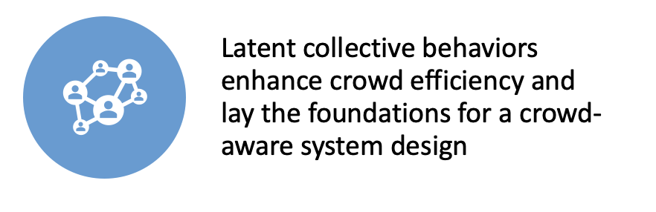
Summary
ACM Web Conference (WWW ’23) Hidden Indicators of Collective Intelligence Horvát, E-Á., et al

Slide 22

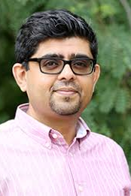



Brian Uzzi
Northwestern University
uzzi@northwestern.edu
Jayaram Uparna Indian Institute of Management
jayaram.uparna@iimu.ac.in
Ágnes Horvát
Northwestern University
a-horvart@northwestern.edu
Henry Dambanemuya
Northwestern University
hdambane@u.northwestern.edu
Thank You!

Slide 23

Hidden Indicators of Collective Intelligence in Crowdfunding
Horvát, E-Á., Dambanemuya, H.K., Uparna, J.S., and Uzzi, B.
Northwestern University
ACM Web Conference (WWW ’23)

Slide 24
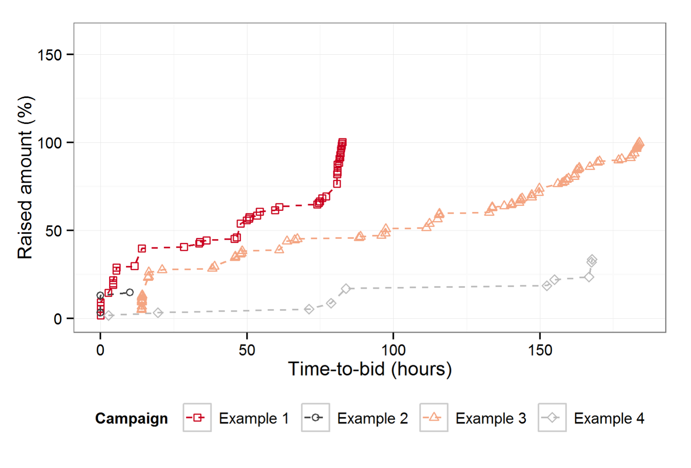


Collective Intelligence in Crowdfunding
Can crowds of untrained individuals accurately predict loan outcomes?
How about compared to expert lenders?
Opinion diversity
→ Inequality of amounts
Aggregation speed
→ Average inter-event time

Slide 25
Opinion Diversity and Aggregation Speed predict funding and repayment
A two-step sample selection bias model (Heckman 1976)
The likelihood of successful fundraising and repayment increases with more diversity and faster aggregation
ACM Web Conference (WWW ’23) Horvát, E-Á., et al
Notes:
We use a two-stage Heckman model
The table shows the regression coefficients for fundraising as the selection variable and repayment as the outcome variable.
the model replicates prior work …. significantly associated with who gets funded and who repays
We find that the two indicators (diversity and speed) accurately predict the probability of successful fundraising and loan payment.
When modeling funding and repayment, we evaluate the predictive power of diversity and speed by also controlling for additional variables like the amount requested and credit grade.
It’s important to note that our data has a selection bias because funded projects are not randomly selected from all possible campaigns.
To account for this, we use a two-step sample selection bias model.
The model indicates that diversity and speed are positively and significantly associated with funding and repayment success.

Slide 26
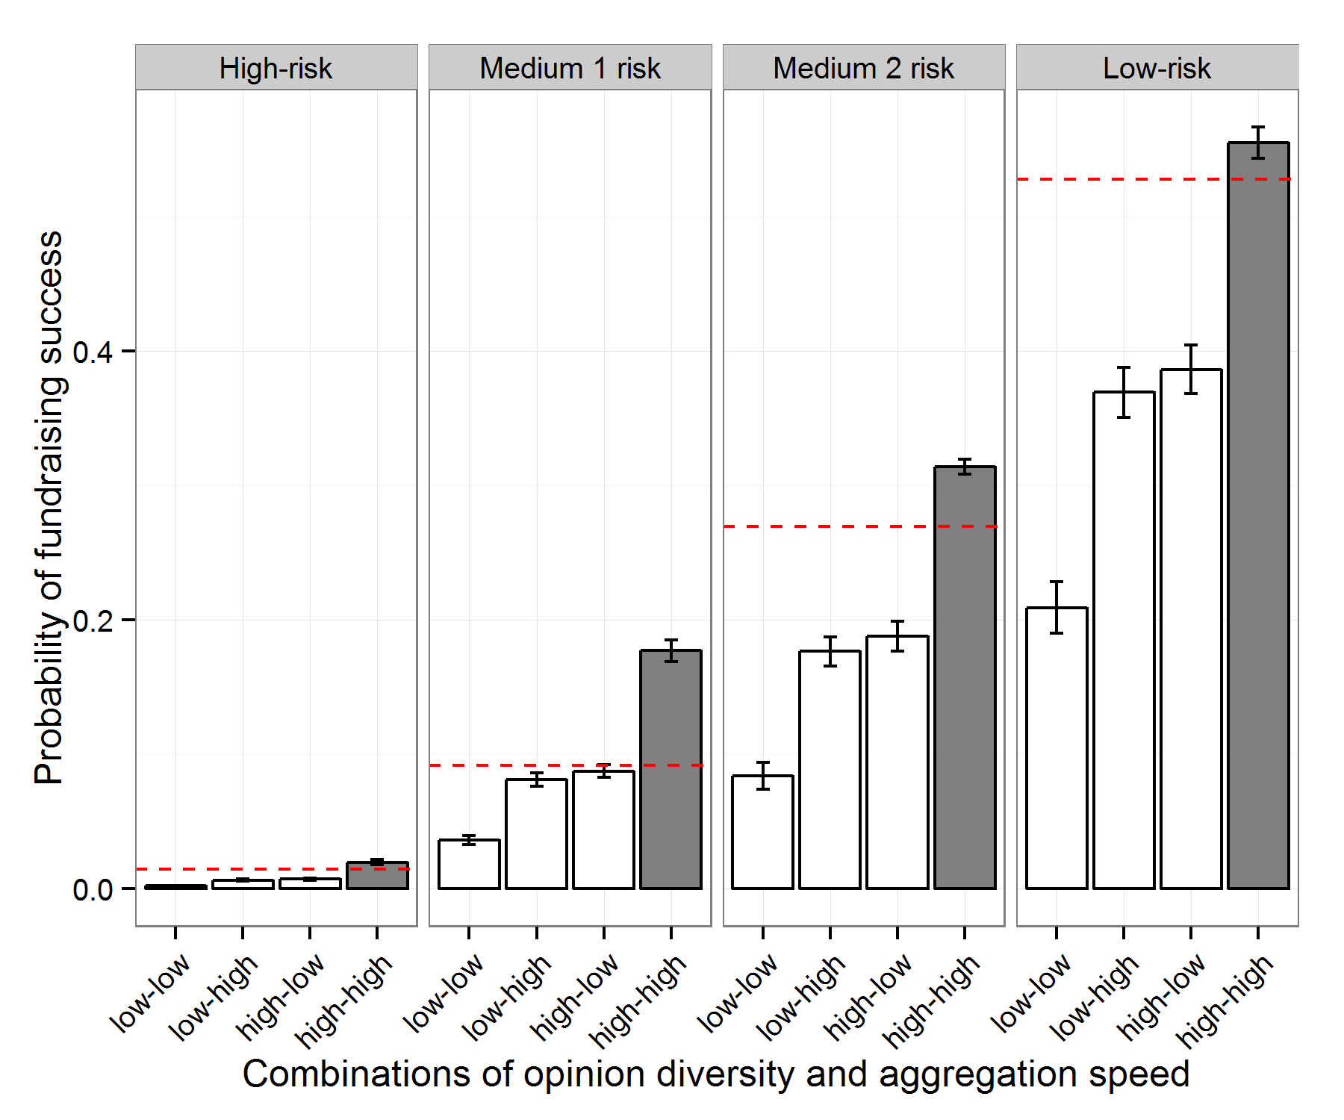
Accuracy of crowd lending depending on risk
Risk categories are based on borrower credit grade & amount sought
High diversity and high speed maximize crowd wisdom: up to 92.9% better than the base rate
ACM Web Conference (WWW ’23) Horvát, E-Á., et al
Notes:
The collective intelligence indicators are associated with project outcomes regardless of the risk level.
I show the estimates of the likelihood of successful fundraising and repayment conditional on combinations of diversity and speed for four risk-reward levels grouped by low and high borrower credit rating and low and high loan amounts.
The estimates are computed by adding interaction effects into the regression shown eralier
In this figure generated from the Heckman selection model, the dashed horizontal red line indicates the base rates for the probability of fundraising and repayment in each of the risk categories
Campaigns that have high diversity and high speed make better predictions about the creditworthiness of a borrower and a borrower’s likelihood of default than expected by the base rate in seven out of eight risk categories
High-diversity and high-speed campaigns can be up to 92.9% better than predicted by the base rate
In all 4 risk categories, the lift from crowd wisdom over the base is statistically significant.

Slide 27
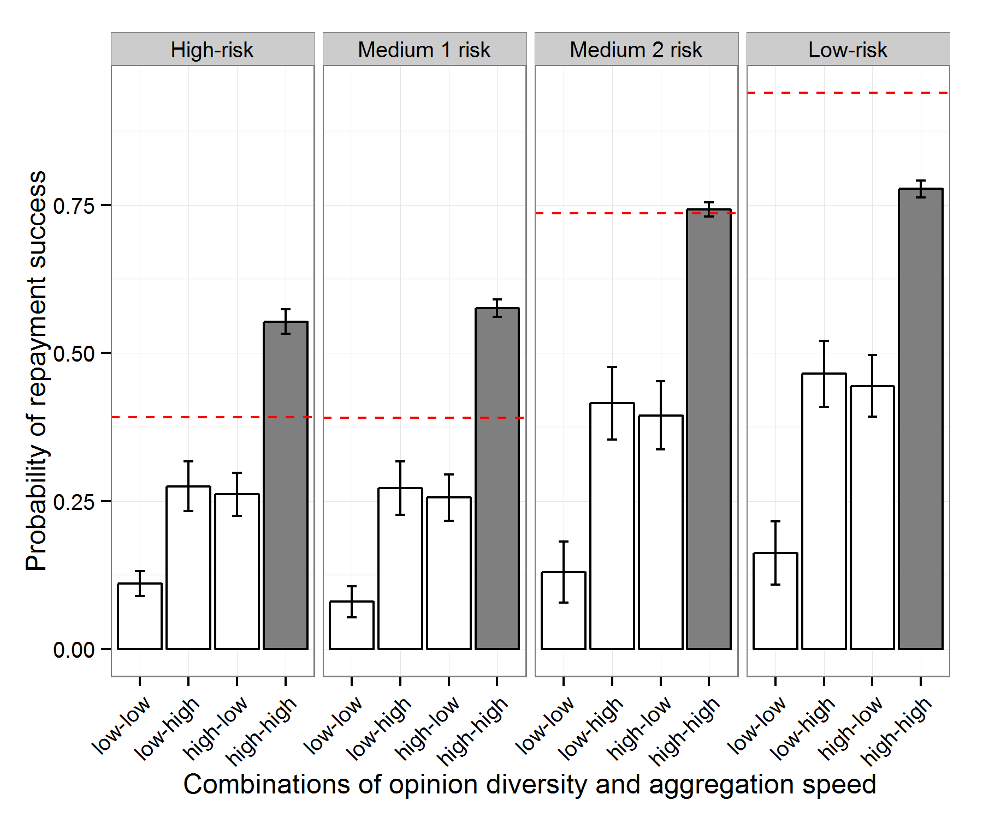
Accuracy of crowd lending by project riskiness
Risk categories are based on borrower credit grade & amount sought
The crowd underestimates the success of low-risk campaigns (1.2% of all campaigns)
ACM Web Conference (WWW ’23) Horvát, E-Á., et al
Notes:
The same analysis for repayment shows that the high diversity and high speed condition outperforms the baseline in all cases, except the 1.2% of the campaigns that are low-risk and yet have a higher success rate than expected by our indicators
The four repayment categories indicate the most interesting and important theoretical and practical findings from our study.
We see that the lift provided by crowd wisdom is statistically and substantially greater than expected by the base rate in the two categories with the highest risk.
In the high-risk category, for example, the base rate estimates a repayment in roughly 40% of the cases.
In contrast, the combination of high diversity and high speed correctly predicts repayment 55.3% of the time.
Overall, we see that campaigns that are high on one but not both collective intelligence indicators have a success rate between 43.7% and 95.2% of the base rate, while campaigns that are low on both indicators (low diversity and low speed) have success rates up to 14.1% lower than the base rate.

Slide 28
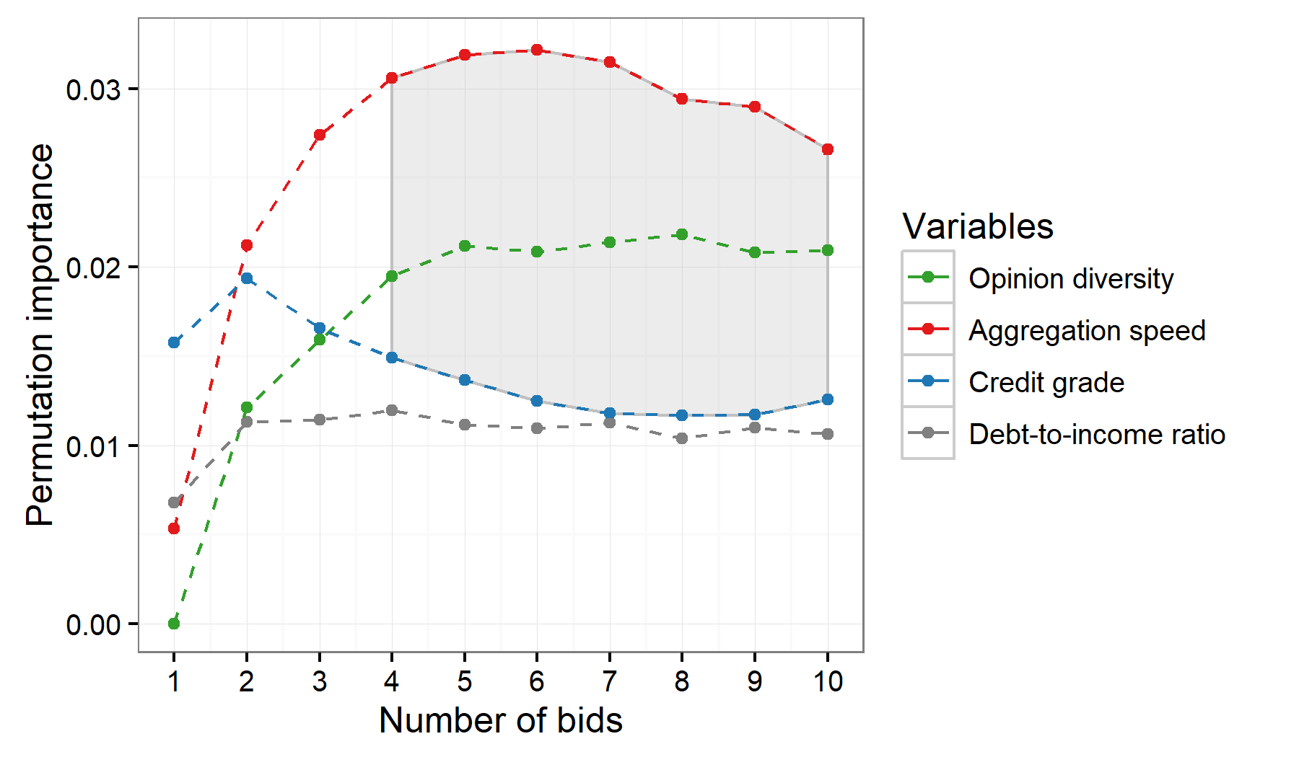
Predicting fundraising from early campaign dynamics
Forecasts made with random forests; assessment of predictive power
At only 4 bids, both collective intelligence signals become more predictive than credit grade
ACM Web Conference (WWW ’23) Horvát, E-Á., et al
Notes:
We make several forecasts at the beginning of campaigns using random forests and assess the predictive power of collective intelligence indicators in comparison with other variables.
Initially, credit grade is a better predictor than the collective intelligence signals, however, after 4 loan contributions, both CI indicators have a higher permutation importance.

Slide 29
Summary
Decision-making as a collective effort and the ability of untrained crowds to select creditworthy proposals
The collective intelligence indicators, opinion diversity and aggregation speed, are predictive of who gets capital and who pays back
Collective intelligence indicators serve as early warning signals of successful fundraising
Latent collective behaviors enhance crowd efficiency and lay the foundations for a crowd-aware system design
ACM Web Conference (WWW ’23) Horvát, E-Á., et al
Notes:
In summary, we model decision-making as a collective effort and show the ability of untrained crowds to select creditworthy proposals
The collective intelligence indicators …
We further show that the collective intelligence indicators serve as …. As the crowd can concur on determinations of creditworthiness after only as few as four bids
Our findings pinpoint a key component, which is central to human computation more broadly i.e., latent collective behaviors that enhance crowd efficiency and lay the foundations for a crowd-aware system design.

